Slide 1
Distribution Statement A. Approved for public release: distribution is unlimited.

Slide 2

Agenda
Introduction
History of the Old Crows
Electronic Warfare (EW)
Chapter History
  Education
  Professional Development
  Conferences
Chapter Meetings
Membership
Summary

Slide 3

History of the AOC

Slide 4
Mission
The Association of Old Crows (AOC) is a professional non-profit association educating, connecting and advocating on behalf of its members and stakeholders across the global electromagnetic warfare (EW) and spectrum operations community.

Slide 5
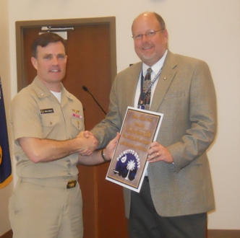
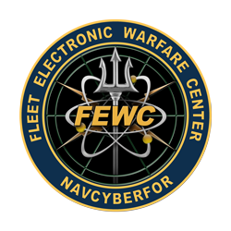


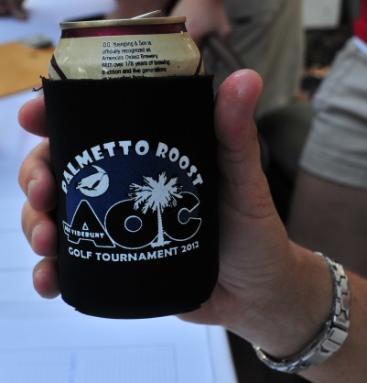

Chapter History
AUG 2009 - Palmetto Roost Chapter was formed to further professions of Cyber, Information Operations (IO) & Electronic Warfare (EW) within the Lowcountry
MAR 2010 - Palmetto Roost hosts
CAPT Hinkley, Commander,
Fleet Electronic Warfare Center
Chapter of the Year (2010)
Chapter of the Year (2011)
Palmetto Roost hosts Wounded Warrior
Project golf tournament and donates
proceeds of $4,000 to support WWP

Slide 6
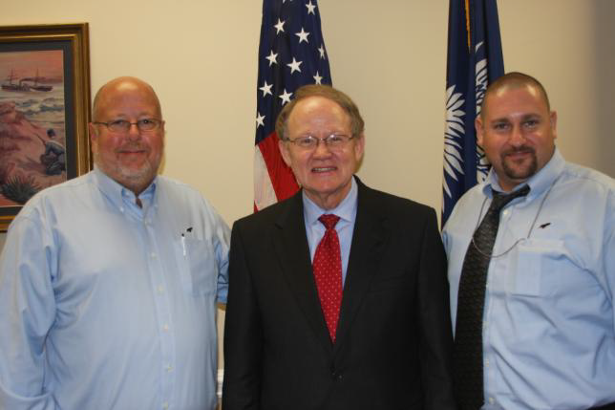


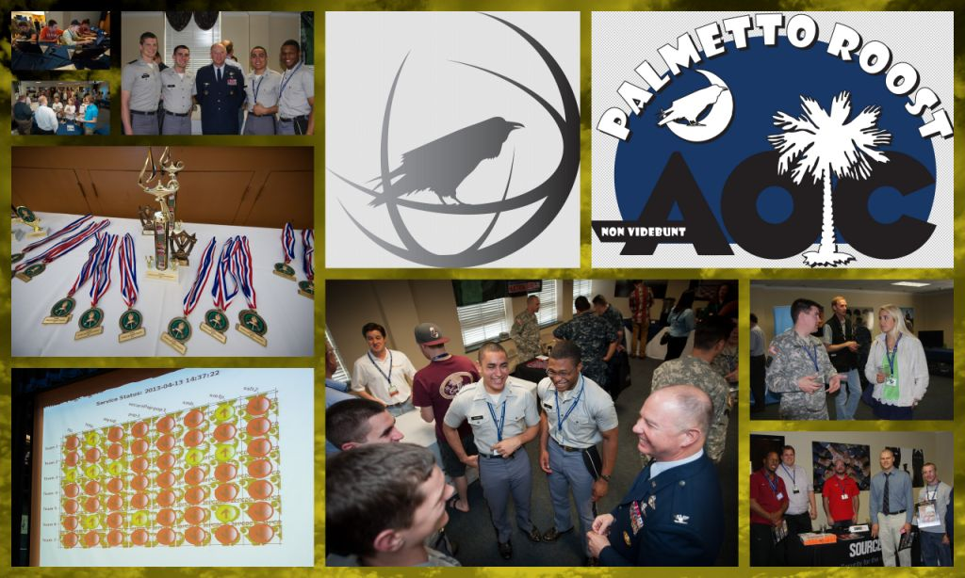

Chapter History
AUG 2012 - Palmetto Roost hosts
VADM McConnell, former
Director of National Intelligence &
Director of the NSA
Chapter of the Year (2012)
APR 2013 – Palmetto Roost
hosts 1st Palmetto Cyber
Defense Challenge (PCDC)
and donates $10,000 worth
of equipment and laptops to
Charleston County
School District

Slide 7
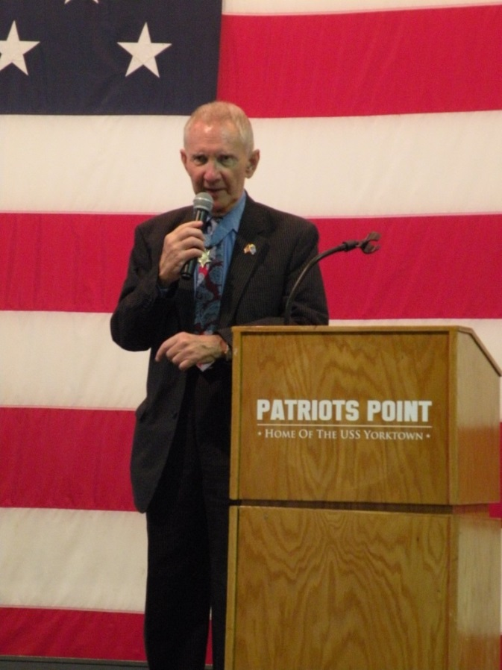
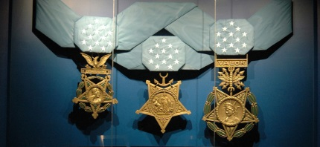
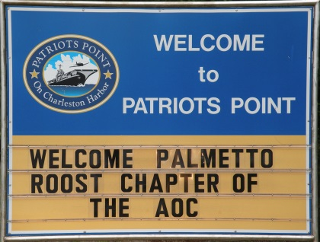
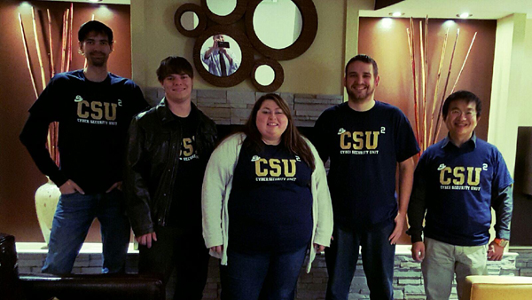
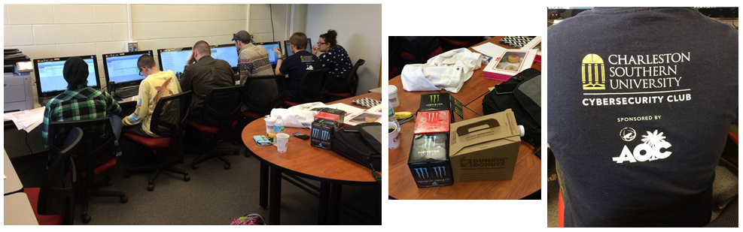
Chapter History
Chapter of the Year (2013)
Palmetto Roost donates $1,000 to
Congressional Medal of Honor Museum in
honor of Maj Gen James Livingston, USMC
Chapter of the Year (2014)
OCT 2015 - CSU Cyber Security Team
Receives $3,000 Education Grant from Palmetto Roost

Slide 8
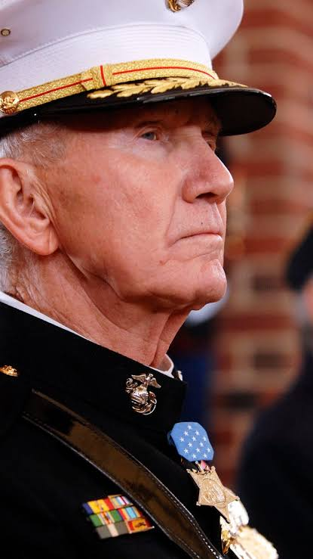
Maj. Gen. James Livingston, USMC
Medal of Honor recipient
  Heroic actions during Vietnam War
Charleston Resident
For conspicuous gallantry and intrepidity at
the risk of his life above and beyond the call
of duty while serving as Commanding Officer,
Company E, 2ND Battalion, 4TH Marines,
9TH Marine Amphibious Brigade in action
against enemy forces in the Republic of Vietnam.
Wounded three times and unable to walk,
he steadfastly remained in a dangerously
exposed area, deploying his men to more
tenable positions and supervising the
evacuation of casualties. Only when assured
of the safety of his men did he allow himself
to be evacuated.

Slide 9


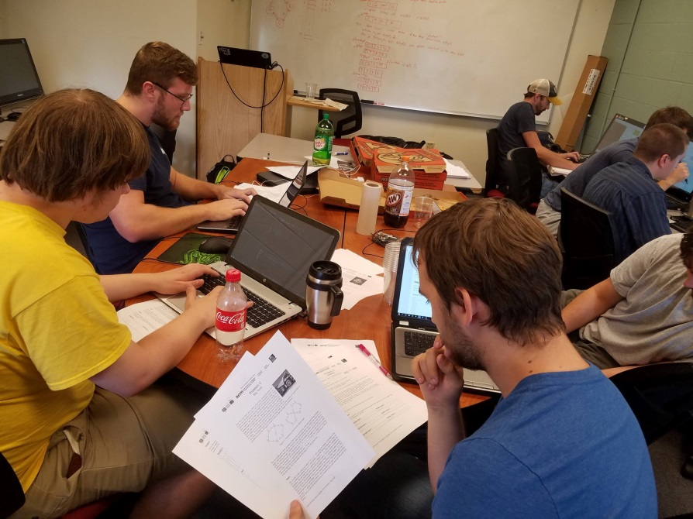
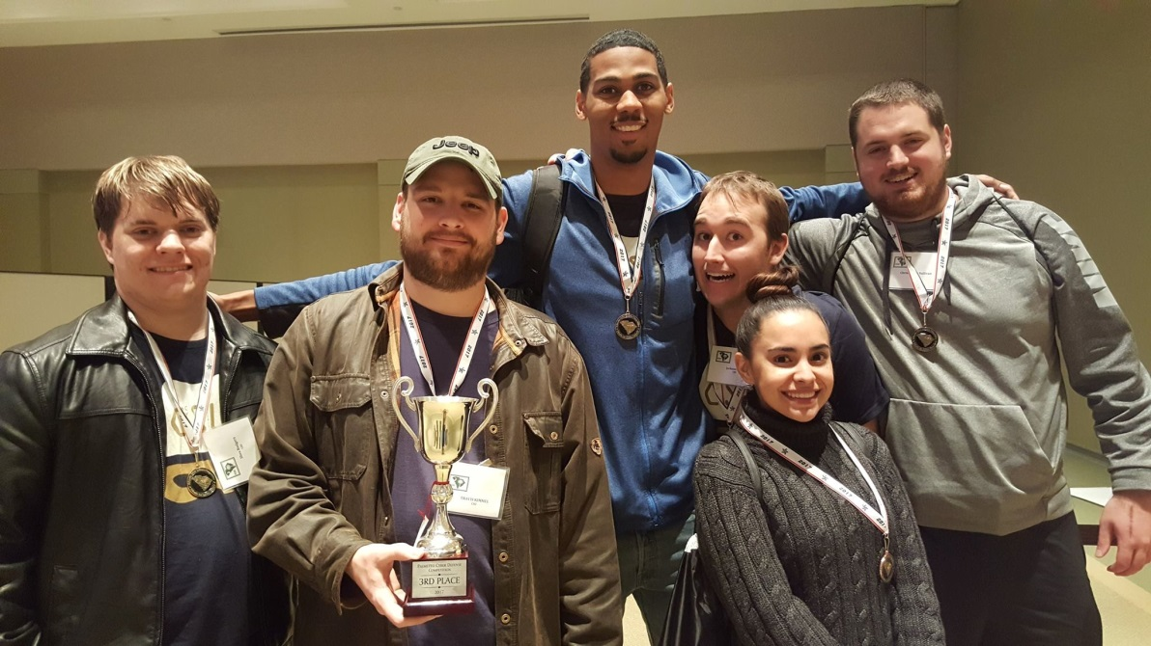
Chapter History
Chapter of the Year (2015)
OCT 2016 - CSU Cyber Security Team Receives another $3,000 Education Grant from the Palmetto Roost
  Roost sponsored CSU team’s travel to CyberSEED
  competition at University of Connecticut
  CSU participates in PCDC (2nd Place (2015) and
  3rd Place (2017) finishes) and South East CCDC

Slide 10
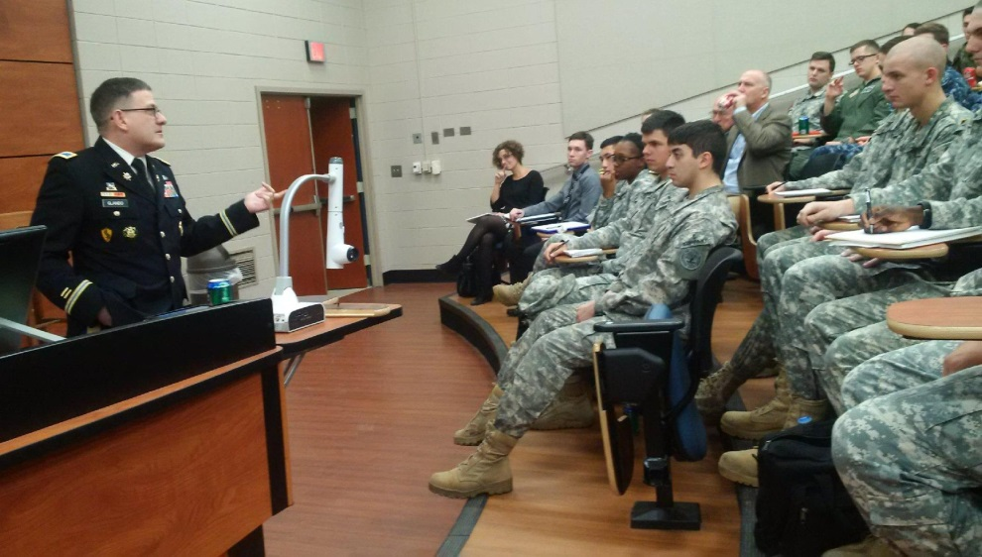

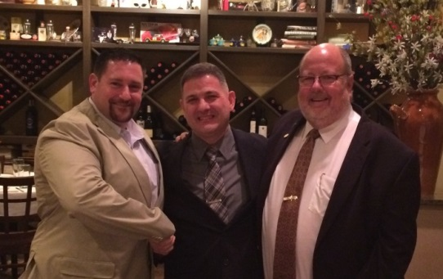
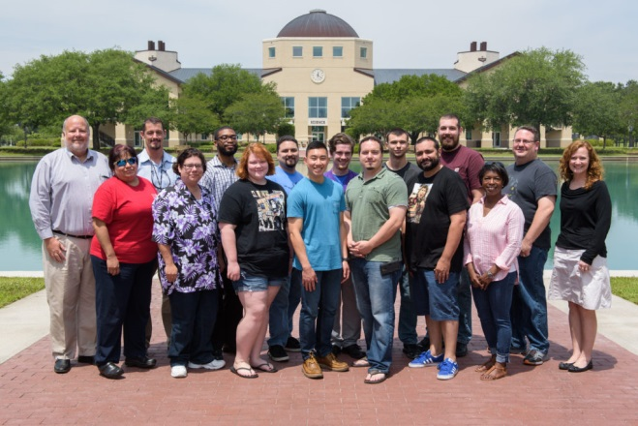
Chapter History
Chapter of the Year (2016)
JAN 2017 - Palmetto Roost hosts
COL Bryant Glando,
USCYBERCOM
MAY 2017 - Palmetto Roost
hosts Network+ Bootcamp for
15 Lowcountry college students
Chapter of the Year (2017)

Slide 11
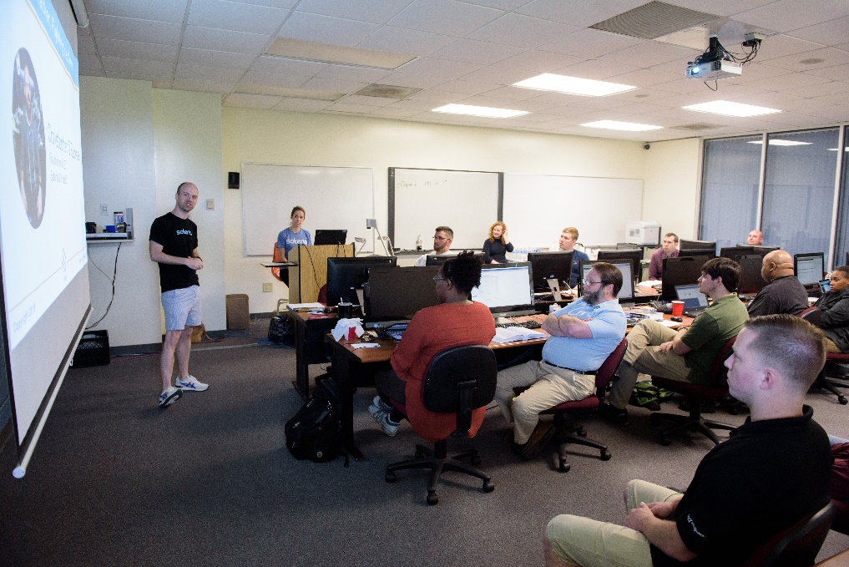
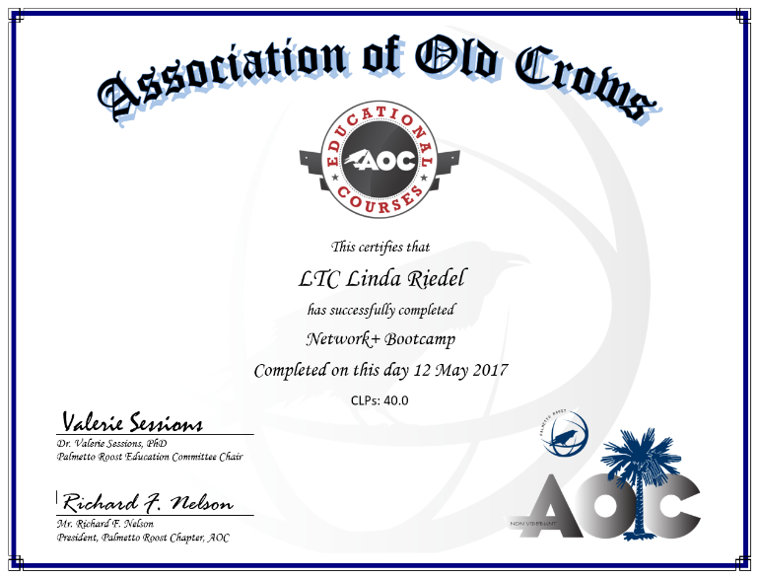
Chapter History
Chapter of the Year (2018)
MAY 2018 – Palmetto Roost
hosts Network+ Bootcamp for
20 Lowcountry college students
Chapter of the Year (2019)
APR 2019 – Roost Honors All
Female Bachelor of Science in
Cybersecurity Class at CSU
MAY 2019 – Palmetto Roost hosts Network+
Bootcamp for 20 Lowcountry college students
Chapter of the Year (2020)
Chapter of the Year (2021)
Chapter of the Year (2022)
Chapter of the Year (2023)
Chapter of the Year (2024)
Chapter of the Year (2025)

Slide 12
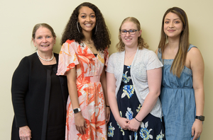
Chapter History
SAT, 11 MAY 2019: Mrs. Rosemary Wenchel, a pioneer in U.S. cyberspace operations for the U.S. Navy, Department of Defense, and the Department of Homeland Security, passed away
The Palmetto Roost announces the establishment of the ROSEMARY WENCHEL MEMORIAL SCHOLARSHIP
  Charleston Southern University

Slide 13
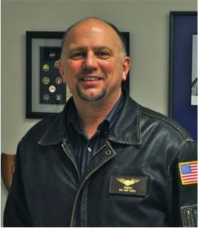
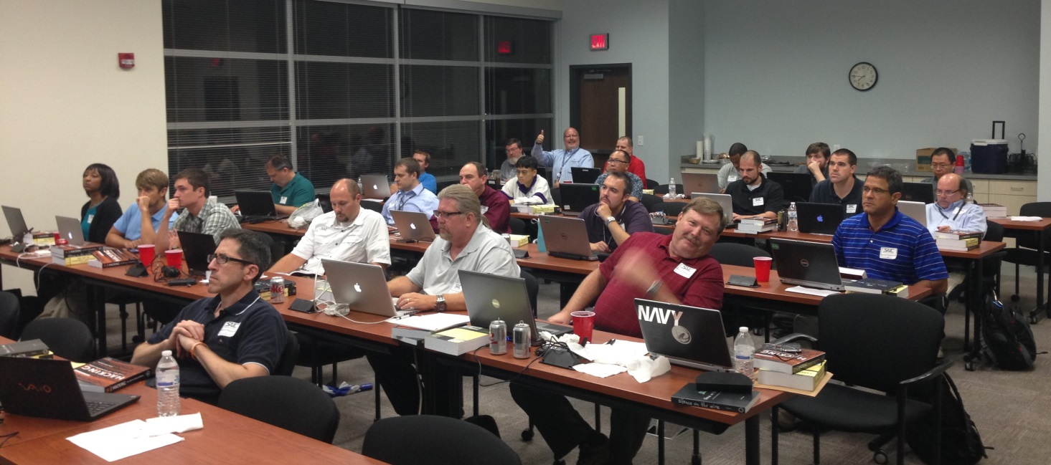
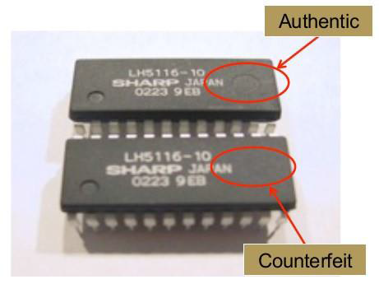
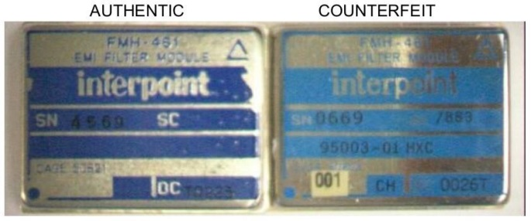
Professional Development
Intelligence Support to Spectrum Operations
Cyber Tools Development Course
Counterfeit Component Workshop

Slide 14



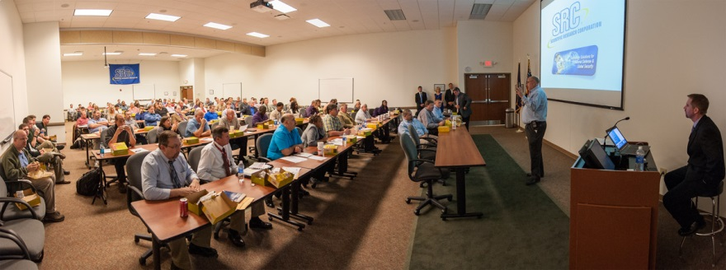

Education
Cyber 101
Cyber 201

Slide 15
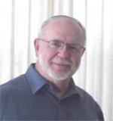
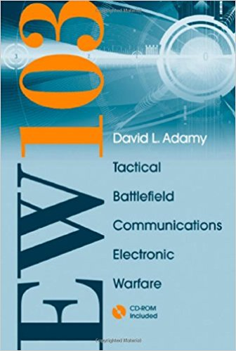
Education
EW 101: A First Course in Electronic Warfare
EW 103: Tactical Battlefield Communications Electronic Warfare
  Dave Adamy is an internationally recognized expert in electronic warfare who writes the popular monthly EW-101 column in the Journal of Electronic Defense magazine. He has over 50 years experience as a systems engineer and program technical director, developing EW systems from DC to Light, deployed on platforms from submarines to space, with specifications from quick reaction capability to high reliability. He has published over 250 professional articles on Electronic Warfare, receiver system design and closely related subjects, including the popular EW101 series in the Journal of Electronic Defense. He has presented dozens of EW courses for military, government and defense industry organizations in the US and allied countries. He holds an MSEE (Communication theory) and has written 16 books on Electronic Warfare and related subjects.

Slide 16

Education
China C4ISR and Counter-Intervention
    Testimony before U.S.-China Economic & Security Review Commission
        Recommendations to Congress include:
        Engage U.S. military regarding future C4ISR strategies & the need to emphasize more defensive capabilities including significant redundancy within U.S. C4ISR system-of-systems
        Invest in significant counter-reconnaissance capabilities to defeat PLA ISR that includes physical, virtual, & electromagnetic camouflage, concealment, & deception measures
        Invest in robust, redundant, and resilient coalition C4ISR links and networks to increase combat interoperability among critical allies and partners, denying PLA battlespace information dominance that might separate U.S. from a coalition
        Fund additional U.S. Intelligence Community capabilities to analyze current & future PLA counter-C4ISR capabilities and strategies
        Fund additional U.S. Intelligence Community capabilities to analyze current and future PLA electromagnetic spectrum operations capabilities and strategies
J. Michael Dahm
Senior Resident Fellow for
Aerospace & China Studies
The Mitchell Institute for Aerospace Studies

Slide 17
CLASSIFIED Conference
Cyber and EW work that Naval Information Warfare Center is responsible for
CLASSIFIED conference provides greater opportunity for collaboration
Makes a significant impact

Slide 18
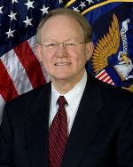
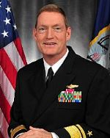
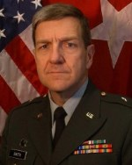
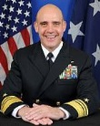
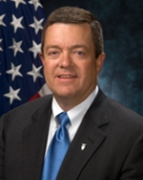
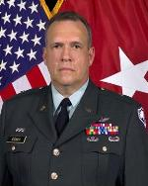
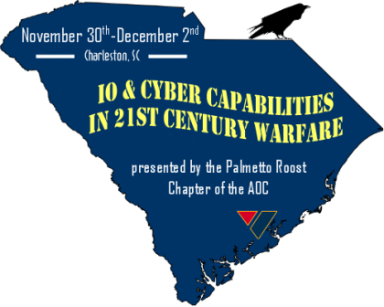
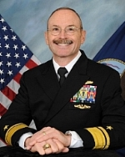
2010 Conference Keynote Speakers
Vice Admiral "Mike" McConnell
  2nd Director of National Intelligence / 13th Director of the NSA
Major General Steven Smith
  Director, Army Cyberspace Task Force
Rear Admiral Kendall Card
  Director of Concepts, Strategies & Integration for Information Dominance (OPNAV N2/N6)
Major General Lester Eisner
  Assistant Adjutant General
  SC Army National Guard
Rear Admiral Sean Filipowski
  Director for Cyber, Sensors, & EW on OPNAV Information Dominance Staff
Rear Admiral Edward Deets, III
  Commander, NETWARCOM
Mr. Mark H. Johnson, SES
  Director, Joint Information Operations Warfare Center

Slide 19
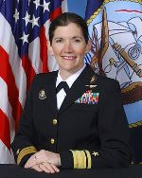
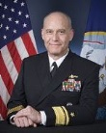
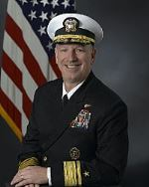

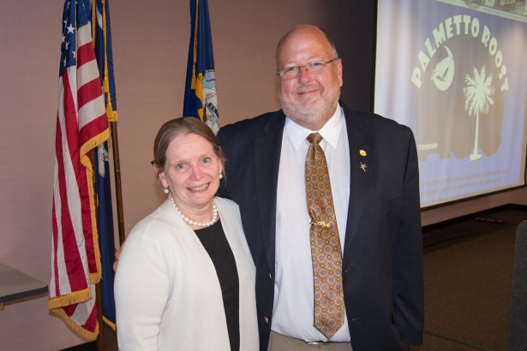
2011 Conference Keynote Speakers
Rear Admiral Margaret “Peg” Klein
  Chief of Staff, USCYBERCOM
Rear Admiral Andrew Singer
  Director for Intelligence, USPACOM
Rear Admiral Ken Deutsch
  Director, Capabilities & Resource Integration (N8)
  U.S. Fleet Forces Command
Mrs. Rosemary S. Wenchel, SES
  Director Cyber, IO and Strategic Studies, OUSD(I)

Slide 20
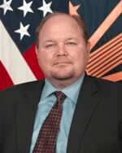
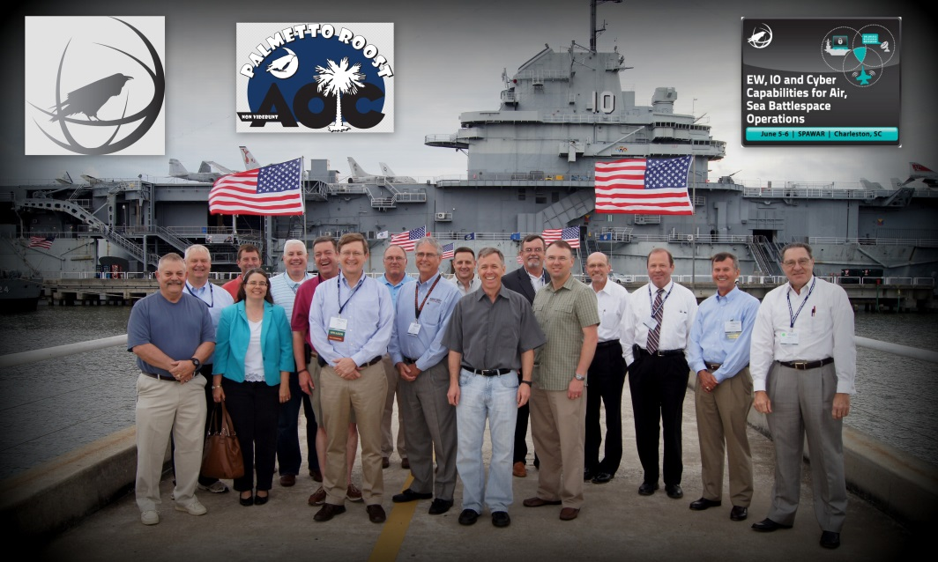
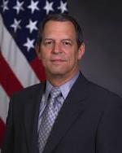
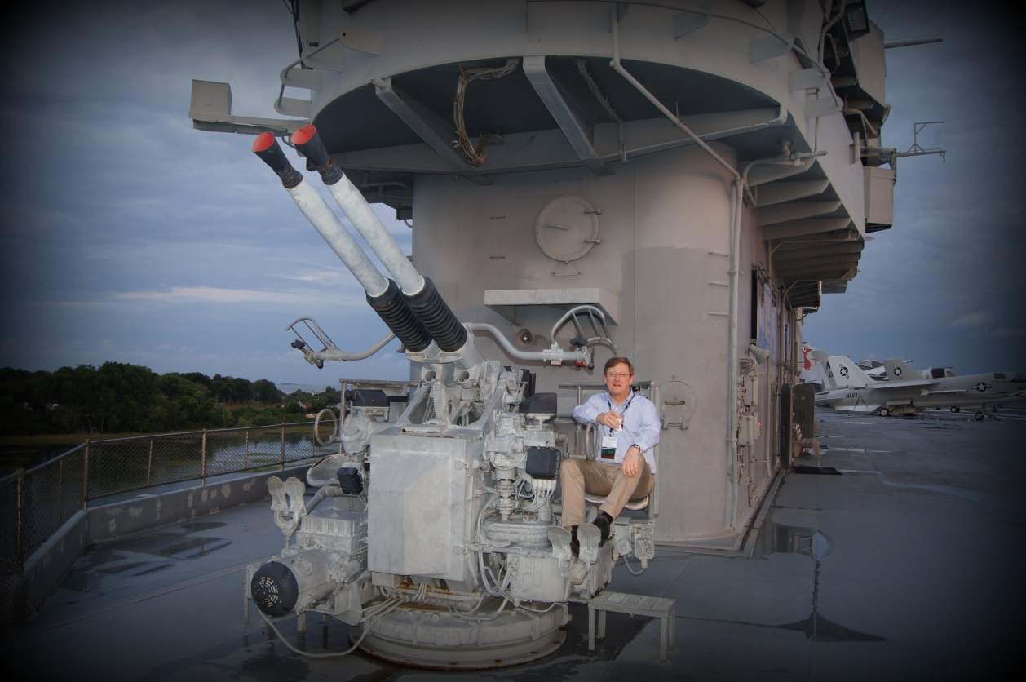

2012 Conference Keynote Speakers
F. Austin Branch, SES
Senior Advisor for IO Strategy
& Plans, OUSD(P)
Mr. Jay R. Kistler, SES
Director, EW & CM Office
Office of the Assistant Secretary
of Defense (R&E)
Mr. Robert Giesler, SES
Director, IO and Strategic Studies

Slide 21
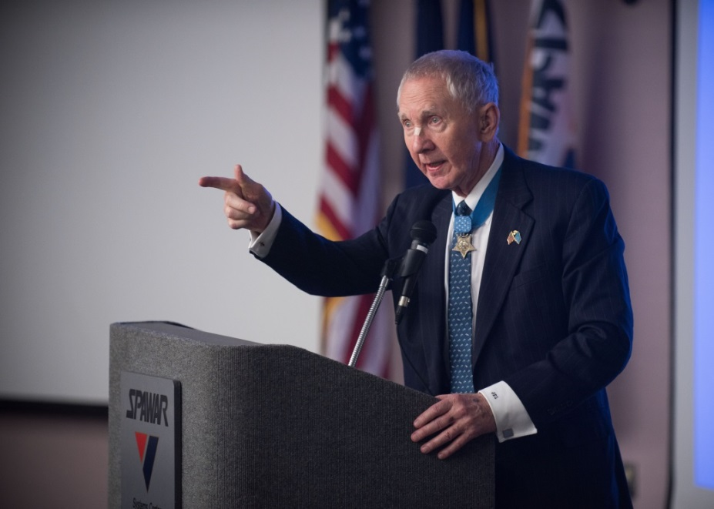
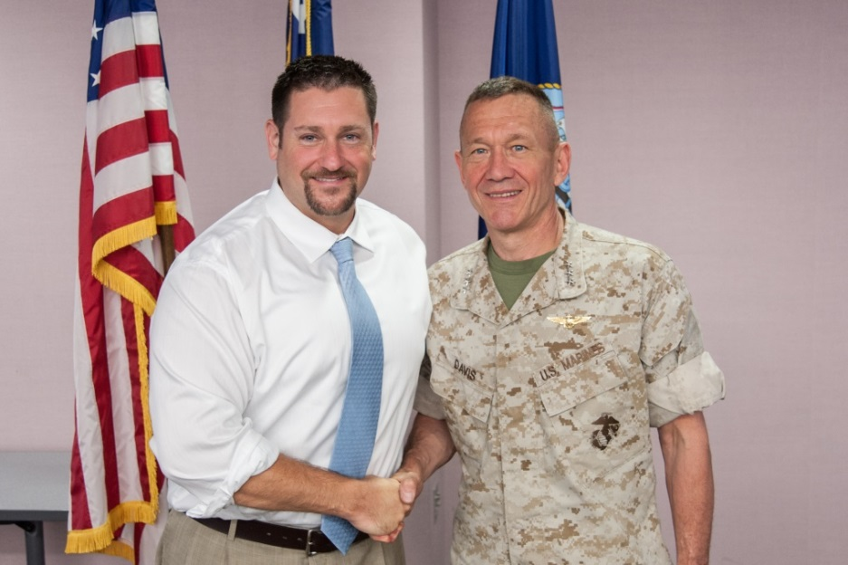
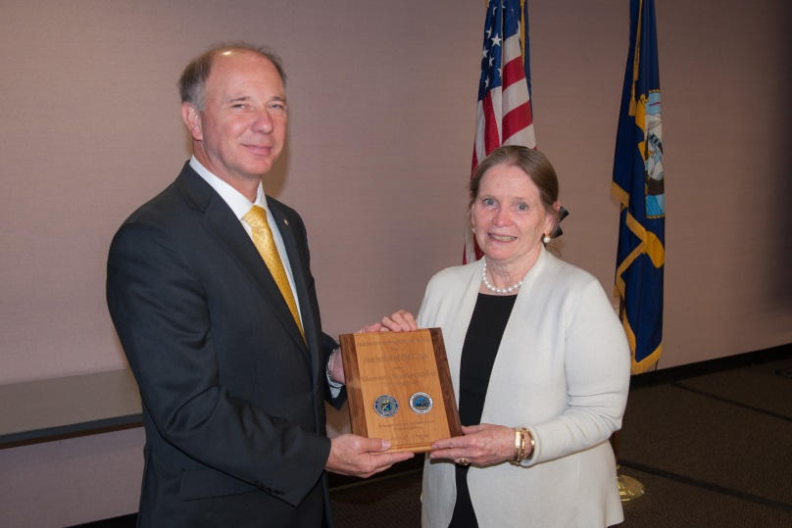
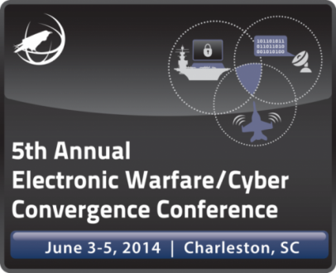
2014 Conference Keynote Speakers
Major General James E. Livingston, USMC (Ret.)
  Medal of Honor Recipient
Lieutenant General Jon Davis
  Deputy Commander, USCYBERCOM
Ms. Rosemary Wenchel, SES
  Deputy Assistant Secretary for
  Strategy & Policy/Cybersecurity
  Coordination National Protection
  and Programs Directorate, DHS

Slide 22
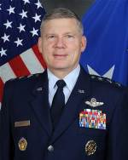
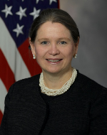
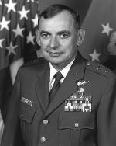
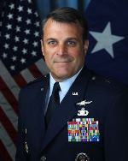




2015 Conference Keynote Speakers
Lieutenant General Bob Elder, USAF
  Commander, 8th Air Force
  Air Combat Command
Ms. Rosemary S. Wenchel, SES
  Acting Assistant Secretary for Cyber Policy,
  Office of Policy, DHS
Major General Ken Israel, USAF
  Director, Defense Airborne Reconnaissance
  Office
Brigadier General Peter Lambert, USAF
  Vice Commander, 25th Air Force

Slide 23








2016 Conference Keynote Speakers
Major General James Livingston, USMC (Ret.)
Colonel Bryant Glando, USCYBERCOM
Major Barbara Mesaros, SCARNG
  J2 Director of Intelligence

Slide 24






2017 Conference Keynote Speakers
Major General Burke E "Ed" Wilson, USAF
  Deputy Principal Cyber Advisor to the Secretary of Defense
  and Senior Military Advisor for Cyber, OUSD(P)
Brigadier General Ryan Heritage
  Deputy Director, Future Operations, J3, USCYBERCOM
Ms. Margaret Palmieri, SES
  Director, Digital Warfare Office
Mr. Greg Schaffer, SES
  Assistant Chief Engineer Mission Architecture and
  System Engineering National Competency Lead
  IO/ISR, SPAWAR

Slide 25





2018 Conference Keynote Speakers
Lieutenant General David Deptula,
USAF
  First Deputy Chief of Staff for Intelligence,
  Surveillance, and Reconnaissance
      Major General Michael Regner, USMC
        Staff Director, Headquarters Marine Corps
Mr. Gregg R. Kendrick, SES
  Executive Director, U.S. Marine Corps Forces
  Cyberspace Command
                Mr. Jeffrey Harris, SES
                Former Director, National Reconnaissance Office

Slide 26






2019 Conference Keynote Speakers
General Glenn Walters, USMC
  34th Assistant Commandant of the USMC
  President of The Citadel
Maj. Gen. Robert J. Skinner
  Commander, 24th Air Force

Slide 27





2023 Conference Keynote Speakers
RADM Steven Parode, USN
  Director, Information Warfare,
  Office of the Chief of Naval Operations
      Mr. Chris Miller, SES
          Executive Director, Naval Sea Systems Command
Mr. Peter Belk, DISES
  Deputy Director Operations, USNORTHCOM

Slide 28

2026 Conference
Save the Date:
02-03 JUN 2026
The Palmetto Roost Chapter of the
Association of Old Crows presents:
EW/Cyber Convergence

Slide 29



Chapter Meetings
The Palmetto Roost meets the 4th Thursday of the month at
The Dinghy: 11:30 – 12:30
8 J C Long Blvd | Isle of Palms

Slide 30
AOC Membership
    Become a member of the only professional association that represents YOU,
    the subject matter experts in EW, IO, EMSO, and CEMA.
AOC membership unlocks valuable benefits designed to help you advance your career, expand your professional network, and grow as a leader in EW.
Critical knowledge: Stay at the forefront of the field with exclusive access to the Journal of Electromagnetic Dominance and a seat in the virtual audience during live recordings of the From the Crows' Nest podcast.
Global networking: Connect with professionals worldwide through local chapters, international conferences, and specialized regional summits. Build valuable relationships across government, defense, industry, and academia in your field.
Cross-domain education: Enhance your expertise through professional development courses, live webinars, and on-demand training sessions that span multiple branches, services, and technical specialties.
Career advancement: Access defense-specific job opportunities and career development resources through the AOC Career Center, while building leadership skills and professional relationships through volunteer opportunities within the association.
Next-gen development: Cultivate the next generation of EW leaders by supporting the Future 5 leadership program, funding and applying for scholarships, and championing outreach to STEM students.
Community recognition: Gain formal acknowledgment of your contributions through AOC's Awards Program while joining a respected community that advocates for EW and EMSO professionals.
Academic and Young Crows (25 and Under): $15!

Slide 31
In Summary…
“The next war will be won by the side that best exploits the electromagnetic spectrum.”

Slide 32
Questions?
CONTACT:
Tim Kuehhas
prez@palmettoroost.org
Dave Walman
veep@palmettoroost.org
www.PalmettoRoost.org

